Slide 1
VOICE RECOGNITION BASED EMAIL USING SMTP AND IMAP SERVERS
BY
A.ABDUL ATHIF (312420104003)
A.ASHOKMITHRA (312420104016)

Slide 2
TABLE OF CONTENTS
Introduction.
Motivation.
Objectives.
Literature Survey.
System Architecture.
Flowchart
Module Explanation.
Results.
Conclusion.
Future Work.
References.

Slide 3
Introduction
E-mails are the most dependable way of communication over Internet, for sending and receiving some important information. Many people find it difficult to manage their emails on a daily basis. Typing out emails on a mobile device can be time-consuming and tedious, they are also challenging for the visually impaired persons. This system aims at developing an email system that will help even a visually impaired person to use the services for communication without previous training. The system is completely built on interactive voice response which will make it user-friendly and efficient to use.

Slide 4
MOTIVATION
A voice-based E-mail system design that allows a blind person to simply and efficiently access E-mails.
Also the voice-based email project aims to make email communication more accessible and convenient for users who have limited typing abilities or who prefer to use voice commands. The project utilizes speech recognition technology to allow users to dictate and send emails using their voice, making it an innovative to use the application in a more effective manner.

Slide 5
OBJECTIVES
The major objectives of the Voice Recognition Email using SMTP and IMAP servers are:
Increasing efficiency.
Improving accessibility.
Enhancing convenience.
Facilitating better Communication.
Reducing errors.

Slide 6
LITERATURE SURVEY:
[1] "A Literature Review on Voice-Based Email Systems" by R. Jeyanthi and K. R. Rajeswari (International Journal of Advanced Research in Computer Science and Software Engineering, 2015)
This literature review paper provides an overview of the existing literature on voice-based email systems, including their benefits, challenges, and potential applications. The paper also discusses the various techniques and technologies used in these systems, such as speech recognition and natural language processing.

Slide 7
LITERATURE SURVEY:
[2] "Voice-Based Email for the Visually Impaired: A Literature Review" by G. Mahadevan and M. Jayasree (International Journal of Emerging Trends in Computing and Information Sciences, 2015)
This literature review paper focuses specifically on the use of voice-based email systems for individuals with visual impairments. The paper reviews the existing literature on the accessibility and usability of these systems for visually impaired individuals, including the various assistive technologies that can be used to improve their accessibility.

Slide 8
LITERATURE SURVEY:
[3] "Voice-Based Email Systems: A Comprehensive Survey" by V. Sharma and M. M. Sharma (International Journal of Computer Applications, 2016)
This comprehensive survey paper provides a detailed overview of the existing literature on voice-based email systems, including their architecture, functionality, and various applications. The paper also discusses the various techniques and technologies used in these systems, such as speech recognition and natural language understanding, and reviews the existing research on their accuracy and effectiveness.

Slide 9
LITERATURE SURVEY:
[4] A Systematic Review of Voice-Based Email Systems" by M. R. Hasan and M. A. Hossain (2018) is a comprehensive study that aims to provide an overview of the existing literature on voice-based email systems. The paper examines various aspects of these systems, such as the technologies used, user interfaces, advantages and disadvantages, and their applications in different domains. The authors also identify the gaps in the literature and propose future research directions to improve the design and usability of voice-based email systems. Overall, this review provides valuable insights into the current state of the art in voice-based email systems and their potential for future development.

Slide 10
LITERATURE SURVEY:
[5] "Voice-Based Email Systems: A Review of the Literature" by A. B. Khandakar and J. Islam (Journal of Computer Science and Engineering, 2017)This review paper provides an overview of the existing literature on voice-based email systems, focusing on their benefits, challenges, and potential applications. The paper also reviews the various techniques and technologies used in these systems, such as speech recognition and natural language processing, and discusses the potential privacy and security concerns associated with them.

Slide 11
LITERATURE SURVEY:
[6]"A Review of Voice-Based Email Systems and Their Applications" by M. C. Sharma and A. Verma (2018), the authors present an in-depth analysis of the various applications and benefits of voice-based email systems. They review the current state of the technology and its potential for increasing productivity and accessibility for users. The article also discusses the challenges that need to be overcome for these systems to become more widely adopted, such as addressing security concerns and improving accuracy and reliability of speech recognition technolog

Slide 12
LITERATURE SURVEY:
[7]"Voice-Based Email for People with Disabilities: A Review" by N. A. Khan and T. Ahmad (2019), the authors provide a comprehensive review of voice-based email systems designed to meet the needs of individuals with disabilities. They evaluate the accessibility and usability of these systems, considering factors such as voice recognition accuracy, ease of use, and compatibility with assistive technology. The review highlights the potential of voice-based email systems to enhance communication and accessibility for individuals with disabilities, while also identifying areas for improvement in terms of functionality and usability.

Slide 13
LITERATURE SURVEY:
[8]"Voice-Based Email Systems: A Systematic Review of the Literature" by A. S. Alqahtani and F. Alsolami (2021) presents a systematic review of the literature on voice-based email systems. The authors analyze the advantages, challenges, and applications of these systems in various domains such as healthcare, business, and education. They also discuss the limitations of existing voice-based email systems and provide insights into future research directions. The review highlights the importance of voice-based email systems as an alternative communication medium for individuals with disabilities and those who prefer a more natural and efficient way of communicating.

Slide 14
LITERATURE SURVEY:
[9] "A Systematic Literature Review of Voice-Based Email Systems" by H. A. Al-Bdour and M. Al-Saidi (2019) presents a systematic literature review of voice-based email systems,the authors conducted a systematic literature review of voice-based email systems. They analyzed a total of 30 papers published between 2004 and 2018 and identified several benefits of voice-based email systems, such as improved accessibility for visually impaired users and increased efficiency for users with physical disabilities. The review also highlighted some limitations of the systems, such as accuracy issues and the need for better voice recognition technology. The authors concluded that further research is needed to address these limitations and improve the usability and effectiveness of voice-based email systems.

Slide 15
LITERATURE SURVEY:
[10] "A Review on Voice-Based Email Systems" by S. S. Patil and S. R. Kulkarni (2019) provides a detailed review of various voice-based email systems, such as Google Voice, Siri, and Amazon Echo, along with their features and functionalities. The authors also discuss the advantages and disadvantages of these systems and their potential applications in various fields. The paper also provides a comparison of these systems and highlights the challenges faced by developers in designing efficient and user-friendly voice-based email systems.

Slide 16
LITERATURE SURVEY:
[11]"A Comprehensive Survey of Voice-Based Email Systems" by S. S. Pimple and K. S. Kene (2020) provides an extensive survey of voice-based email systems, including their features, advantages, limitations, and recent advancements. The paper reviews various existing voice-based email systems and analyzes their effectiveness and user-friendliness. The authors also highlight the potential applications of voice-based email systems and their role in facilitating communication for individuals with disabilities. Additionally, the paper discusses the challenges and future directions of research in this area, including the integration of natural language processing and machine learning techniques to enhance the functionality of voice-based email systems.

Slide 17
LITERATURE SURVEY:
[12]"Voice-Based Email Systems: A Systematic Literature Review" by A. A. A. Alkhuzai and N. Alshammari (2020) presents a systematic literature review of voice-based email systems. The authors review various studies on voice-based email systems, including their design, features, and benefits. They also discuss the limitations and challenges of these systems, such as issues with accuracy, security, and user acceptance. The review provides insights into the current state of voice-based email systems and highlights areas for further research and development to enhance the usability and effectiveness of these systems.

Slide 18
LITERATURE SURVEY:
[13] "A Review on Voice-Based Email Systems for Business and Enterprise Communication" by A. N. A. Alshaikh and S. A. Basuni (2020) provides a detailed review of the use of voice-based email systems for business and enterprise communication. The authors discuss the advantages and limitations of these systems and provide insights into their potential for improving communication efficiency and effectiveness in business settings. Additionally, the paper highlights several research gaps in this area and provides recommendations for future research directions.

Slide 19
LITERATURE SURVEY:
[14] "Voice-Based Email Systems: A Literature Review" by A. M. Al-Hattami and S. M. Al-Mahbashi (2021) provides a comprehensive review of the latest developments in voice-based email systems. The authors examine the various approaches and technologies that have been used in the design and implementation of voice-based email systems. They also discuss the benefits and limitations of these systems and highlight future research directions in this field. The paper is a valuable resource for researchers and practitioners who are interested in voice-based email systems and their potential applications in various domains.

Slide 20
LITERATURE SURVEY:
[15]"A Review on Voice-Based Email Systems for Health Care Services" by M. Alotaibi and A. Alamri (2021) presents a review of the use of voice-based email systems in healthcare services. The paper discusses the benefits of using voice-based email systems for healthcare communication and the challenges that need to be addressed in their implementation. It also highlights the importance of privacy and security in the design and implementation of such systems. The review concludes by discussing the potential of voice-based email systems to improve communication and coordination in healthcare services.

Slide 21
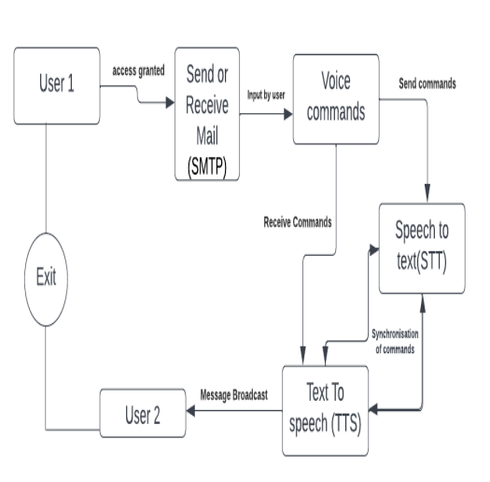
OVERALL SYSTEM ARCHITECTURE

Slide 22
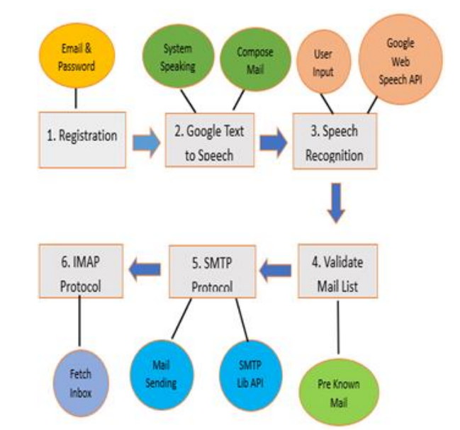

Slide 23
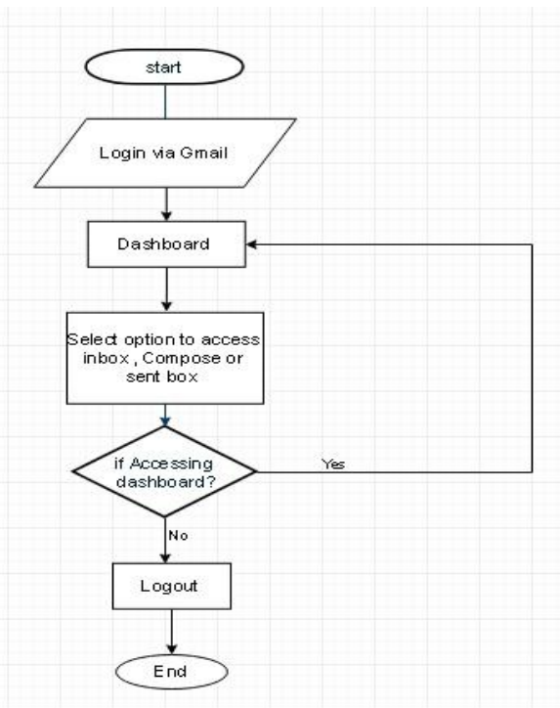
Flowchart

Slide 24
EXPLANATION OF VARIOUS MODULES USED
The various modules used in our project are:
voic.py
information.py
talk.py
send_email.py

Slide 25
Voic.py
The voic.py file is a Python script that provides functions for checking an email inbox using IMAP protocol. Specifically,it allows you to check for unseen emails in inbox and retrieve their details. To accomplish this, the script of uses the built-in imaplib module in Python, which provides an easy-to-use interface for interacting with an IMAP server. It establishes a connection to server, logs in with your credentials,and selects inbox folder to perform the search. The retrieved email data is then printed tothe console, allowing you to see the details of any of unseen emails in your inbox.

Slide 26
Information.py
The information.py file is a Python script that utilizes the Speech Recognition library to perform voice recognition. Specifically, it listens to the user's spoken input and uses Google's speech recognition API to convert it to text. The script can be used to perform a variety of tasks, such as searching the web or retrieving information from a database, based on the user's spoken.

Slide 27
Talk.py
The talk.py file is a Python script that uses the pyttsx3 library to convert text to speech. It initializes a text-to-speech engine using pyttsx3.init() and defines a talk() function that accepts a text input, converts it to speech using the engine's say() method, and then plays the audio using engine.runAndWait(). This script can be useful in applications that require voice prompts or audio feedback, such as virtual assistants or interactive systems.

Slide 28
SEND_EMAIL.PY
The send_email function in this Python script uses the built-in smtplib library to send an email message through a Gmail account. It takes three arguments as inputs: the email address of the recipient (receiver), the subject line of the email (subject), and the content of the email message (message).
This script can be useful for automating the process of sending email messages through a Gmail account, and could be integrated into larger projects or used on its own to simplify email communication. Note that in order to use this script, you will need to replace the email and password values with your own valid Gmail credentials.

Slide 29
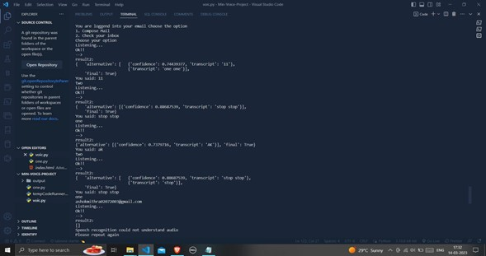
RESULTS

Slide 30
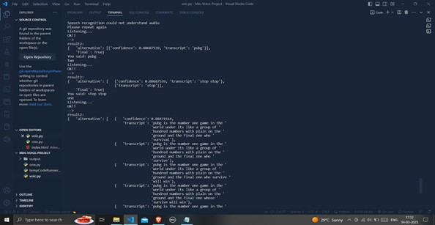
RESULTS

Slide 31
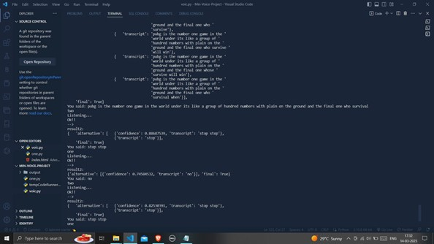
RESULTS

Slide 32
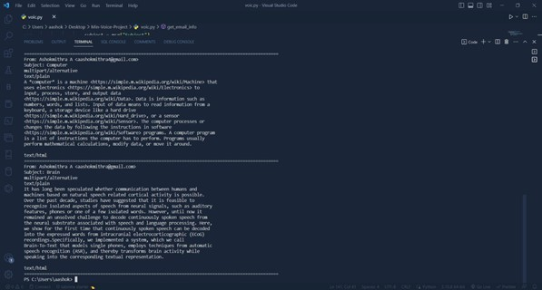
RESULTS

Slide 33
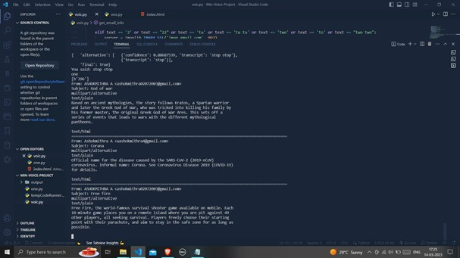
RESULTS

Slide 34
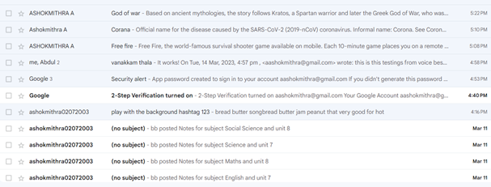
RESULTS

Slide 35
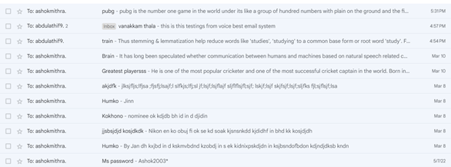
RESULTS

Slide 36
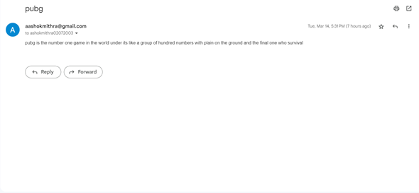
RESULTS

Slide 37
CONCLUSION
The system is quite efficient and accessible to utilize for the communication for the blind people and persons loving voice based applications. There is no need to write or type the messages in the inbox of the email only through your voice’s communication is possible. The system is completely made for physically challenged people for easy communication. It enhances the path of communication in a fast and interesting way. Even the normal users can utilize the system smoothly.However, further research is needed to address some of the challenges associated with voice-based email systems, such as the accuracy of speech recognition and the need for customized interfaces to meet the specific needs of different user groups. Overall, voice-based email systems have the potential to revolutionize the way people interact with email, making it more accessible and convenient for a wider range of users.

Slide 38
FUTURE WORK
There can be wide scope of the system with its functionalities. It can consist of options for reading deleted and spam emails. The system will be more in demand if it will be accessible in all the regional languages. It will promote interaction at a higher level as it will require nothing special to use the system. It can be designed in more advanced ways by adding options of voice call and short messaging services (SMS).We intend to proceed further to improve these ideas and develop a mobile application so that it can be used even more efficiently by everyone. Further adding the proposed functionalities will take it to the global market and also will give facilities to communicate with each other in different ways.

Slide 39
REFERENCE
[1] Jeyanthi, R., & Rajeswari, K. R. (2015). A literature review on voice-based email systems. International Journal of Advanced Research in Computer Science and Software Engineering.
[2] Mahadevan, G., & Jayasree, M. (2015). Voice-based email for the visually impaired: a literature review. International Journal of Emerging Trends in Computing and Information Sciences.
[3] Sharma, V., & Sharma, M. M. (2016). Voice-based email systems: a comprehensive survey. International Journal of Computer Applications.

Slide 40
REFERENCE
[4]Khandakar, A. B., & Islam, J. (2017). Voice-based email systems: a review of the literature. Journal of Computer Science and Engineering.
[5]Sharma, M. C., & Verma, A. (2018). A review of voice-based email systems and their applications. International Journal of Computer Science and Information Technology.
[6] Hasan, M. R., & Hossain, M. A. (2018). A systematic review of voice-based email systems. International Journal of Advanced Computer Science and Applications.

Slide 41
REFERENCE
[7]Khan, N. A., & Ahmad, T. (2019). Voice-based email for people with disabilities: a review. Journal of Computing and Information Technology.
[8]Al-Bdour, H. A., & Al-Saidi, M. (2019). A systematic literature review of voice-based email systems. Journal of Engineering and Applied Sciences.
[9]Patil, S. S., & Kulkarni, S. R. (2019). A review on voice-based email systems. International Journal of Computer Sciences and Engineering.

Slide 42
REFERENCE
[10]Pimple, S. S., & Kene, K. S. (2020). A comprehensive survey of voice-based email systems. International Journal of Innovative Technology and Exploring Engineering.
[11] Alkhuzai, A. A. A., & Alshammari, N. (2020). Voice-based email systems: a systematic literature review. Journal of Communication and Computer.
[12] Alshaikh, A. N. A., & Basuni, S. A. (2020). A review on voice-based email systems for business and enterprise communication. International Journal of Scientific Research in Computer Science, Engineering and Information Technology.

Slide 43
REFERENCE
[13]Al-Hattami, A. M., & Al-Mahbashi, S. M. (2021). Voice_x0002_based email systems: a literature review. International Journal of Computer Science and Network Security.
[14]Alotaibi, M., & Alamri, A. (2021). A review on voice-based email systems for health care services. International Journal of Advanced Science and Technology.
[15] Alqahtani, A. S., & Alsolami, F. (2021). Voice-based email systems: a systematic review of the literature. Journal of King Saud University-Computer and Information Sciences.

